Slide 1
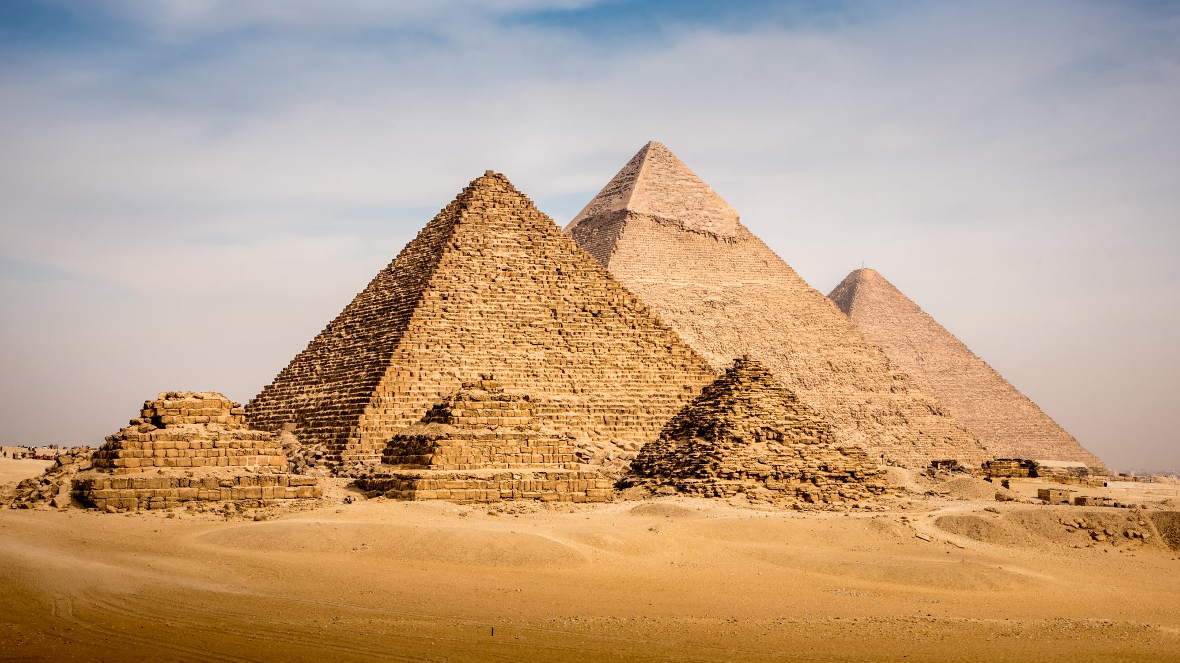
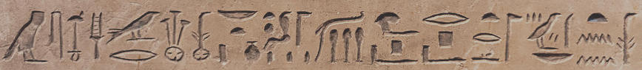
Classifying Egyptian Hieroglyphs
Scott Kroeger

Slide 2
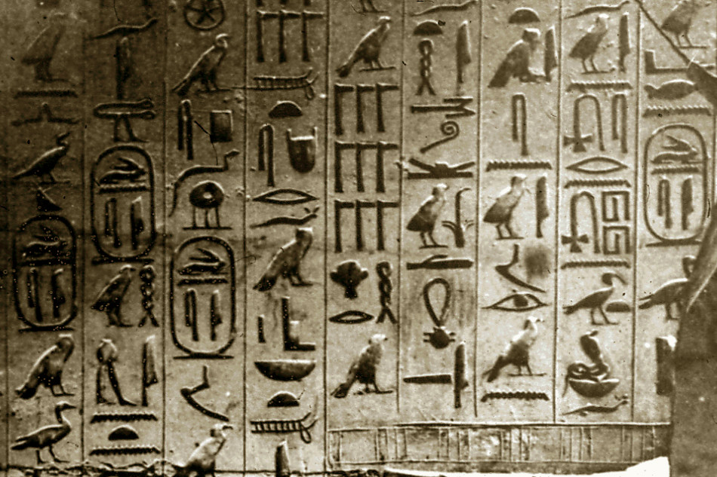
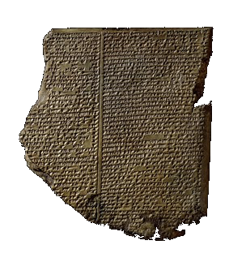
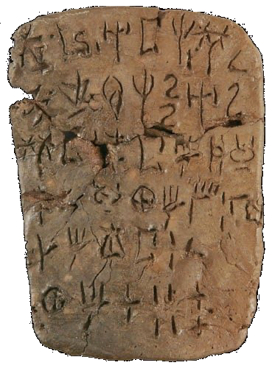
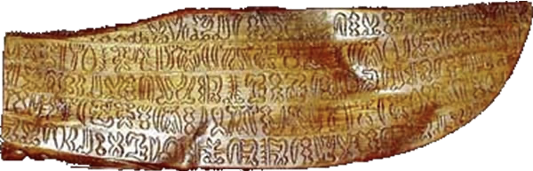
Motivation
hieroglyphs
MINOAN LINEAR A
RONGORONGO
CUNEIFORM

Slide 3
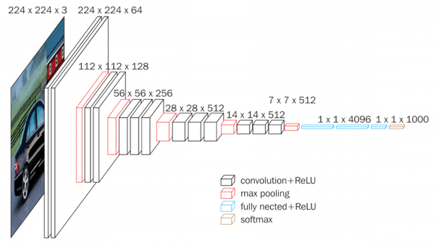


METHODOLOGY

Slide 4
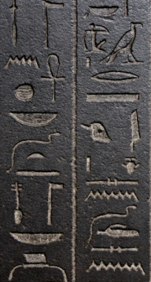
METHODOLOGY
4000 Images
50 Hieroglyphs
Basket
water
water
???
cobra

Slide 5
Preliminary Results
50 Classes
F₁ = 0.95

Slide 6
Densely written hieroglyphs

Slide 7
Traveled to egypt

Slide 8

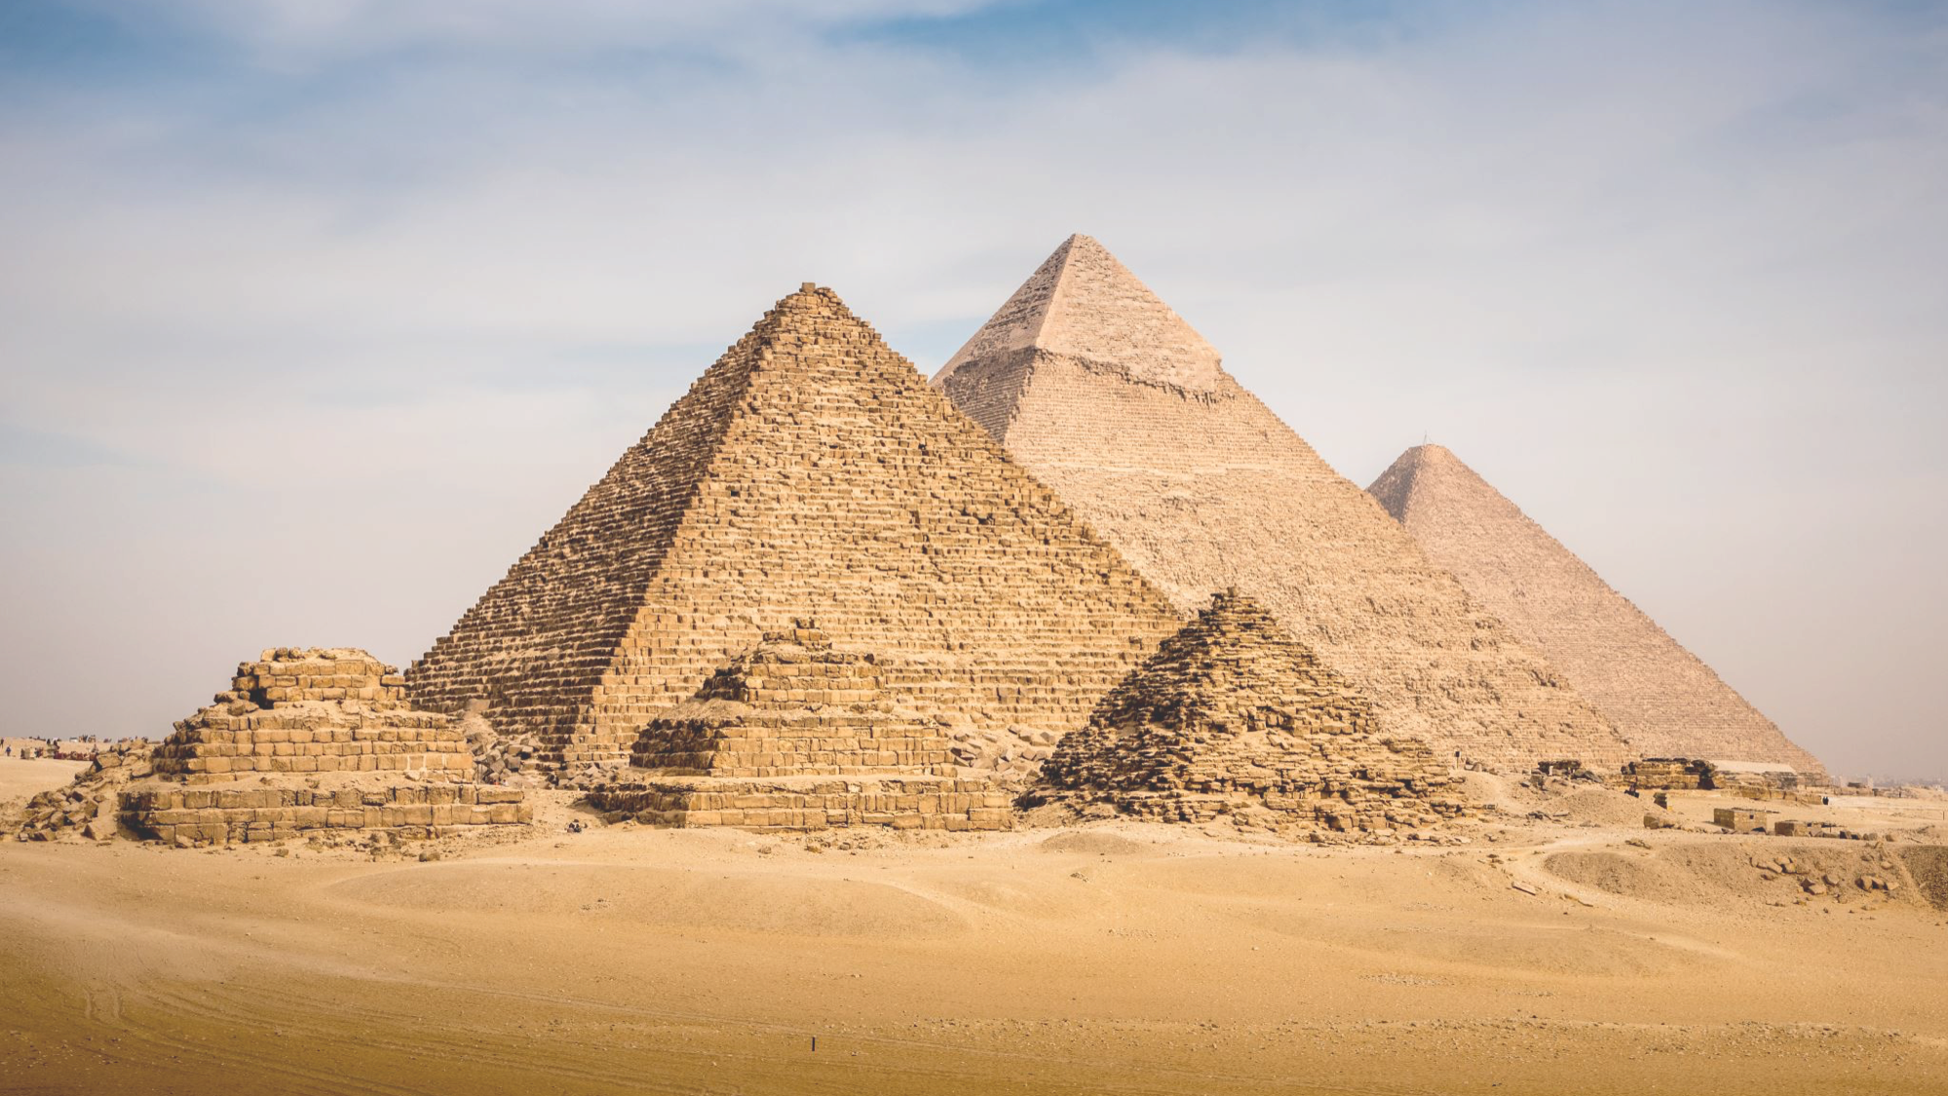
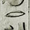
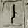
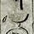
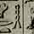
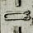
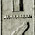
Via the internet
4500 Images
11 Hieroglyphs
Pyramid of Unas

Slide 9
Final results
11 Classes
F₁ = 0.94

Slide 10
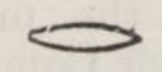
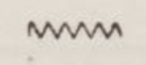
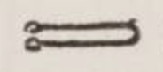
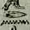
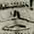
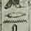
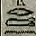
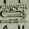
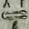
Most common errors
Mouth F₁ = 0.54
Confused with Water
Tether F₁ = 0.59
Confused with Mouth

Slide 11
conclusion
Machine Learning can assist with analysis of ancient texts
Next time I need to go to Egypt for real

Slide 12


Thank you
skroegs@gmail.com
/in/scott-kroeger
Or come say hello and talk about:
Machine learning ● NLP
Hieroglyphs ● Cuneiform

